Slide 1
ANGULAR 5
Võ Tuấn Nguyên – NguyenVT2
Trần Phúc Nguyên – NguyenTP1

Slide 2
Contents
Introduction
Environment
Simple App
Architecture

Slide 3
1. INTRODUCTION
What is the Angular?
JavaScript-based open-source front-end web application framework.
History of Angular
Initial release Angular JS(1.x): October 20, 2010 by GOOGLE
Angular 2: September 14, 2016
Angular 4: March, 2017
Angular 5: November 1, 2017
Angular 6: May 4, 2018

Slide 4
Why Angular?
Main advantage of Angular is MVC.
Typescript:
A project open-source developed by Microsoft.
A superset of Javascript.
Support OOP and constraint data for variables.
Editor:
Sublime Text, Atom, Visual Studio Code, …

Slide 5
2. ENVIRONMENT
Setup NodeJS on www.nodejs.org
“node –v”, “npm -v” in cmd/terminal to check version of nodejs and npm
Setup Angular CLI
“npm install –g @angular/cli” in cmd/terminal
Create Angular Project
“ng new name-of-project” to create project

Slide 6
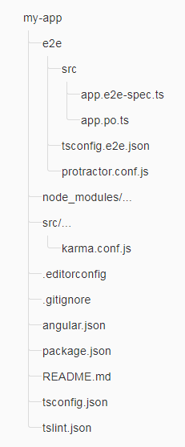
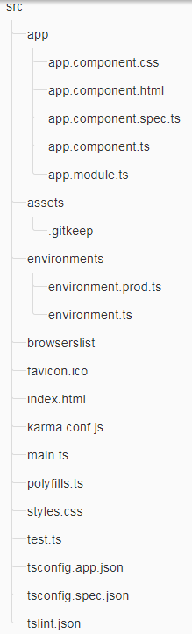
3.SIMPLE APP
Root Folder
src Folder

Slide 7
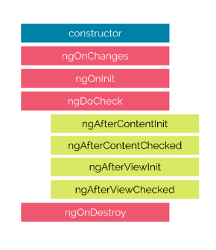
3. SIMPLE APP
Life Cycle

Slide 8
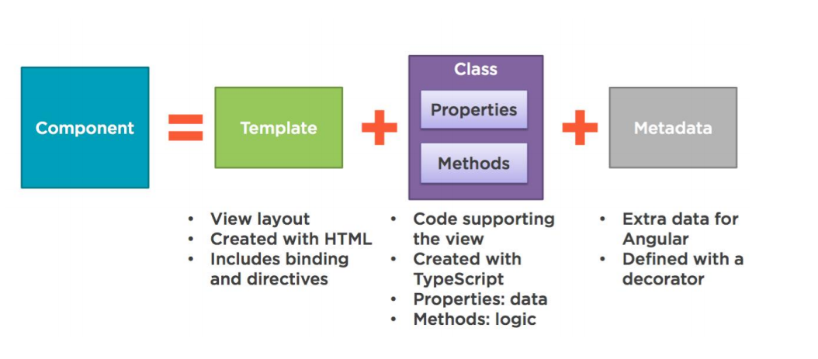
4. ARCHITECTURE 4.1 Component

Slide 9
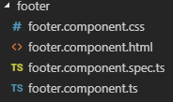
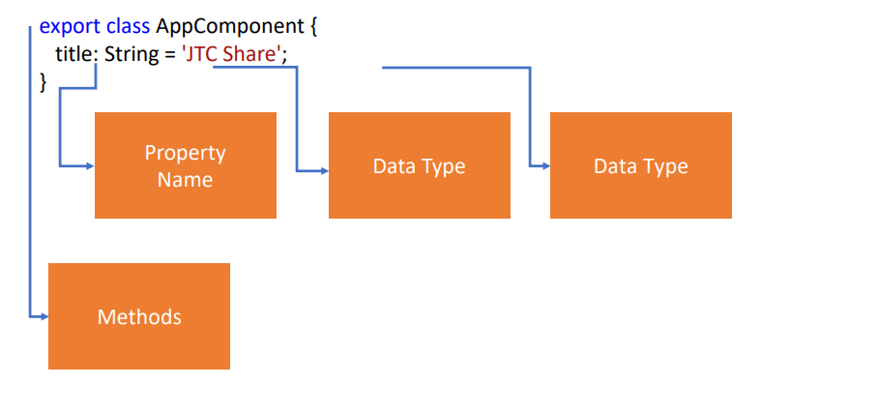
4.1 Component
“ng g c name-of-component” in cmd/terminal to create a new component.

Slide 10
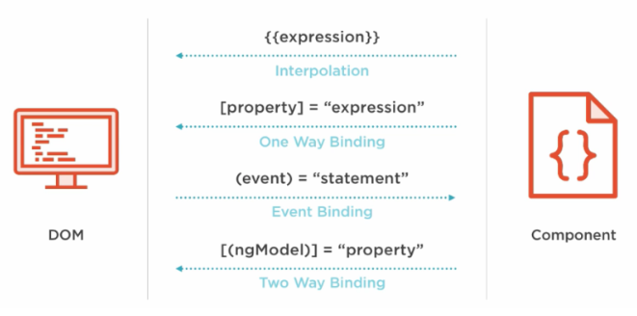
4.2 Binding

Slide 11
4.3 Directives
3 Types of Directives
Component Directives
Structural Directives
Attribute Directives

Slide 12
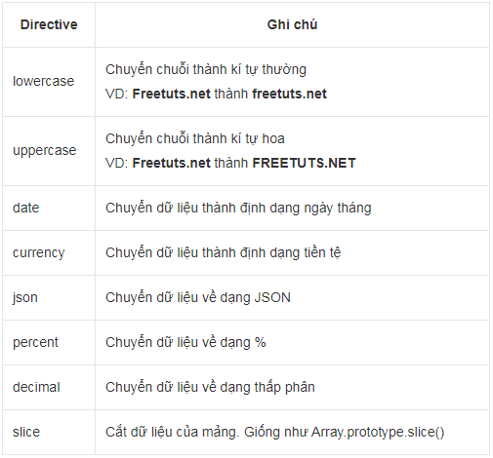
4.4 Pipes
To get data, transform them, and show them to users.
Syntax: {{ Data | Directive}}
Built-in Pipes

Slide 13
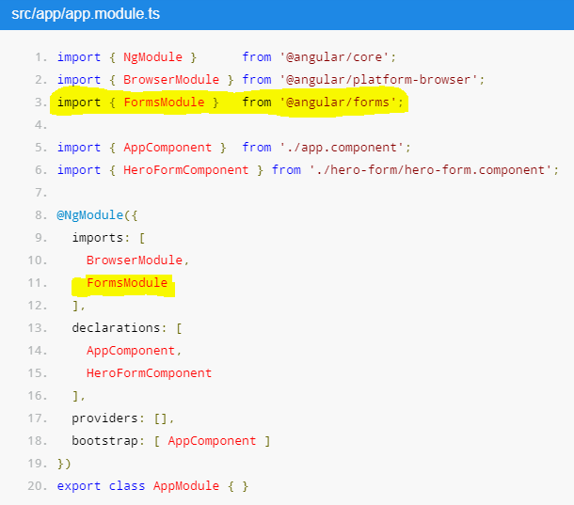
4.5 FORM
Use ‘ngModel’ to create two-way data bindings for reading and writing input-control values
Track state changes and the validity of form controls.
Share information across HTML elements using template reference variables.

Slide 14
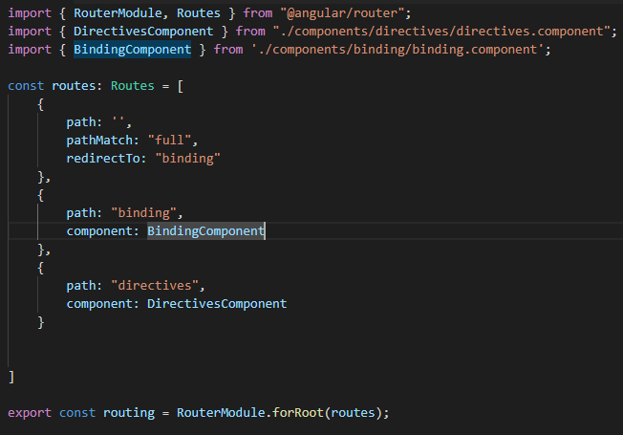

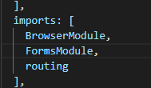
4.6 Routing
The Angular Router enables navigation from one view to the next as users perform application tasks.
Navigate between two page by using the path of component.

Slide 15
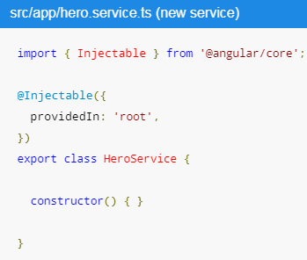
4.7 Service
Help to fetch data from web service
Share data among any components
Create service
“ng g s name-of-service” in cmd/terminal

Slide 16

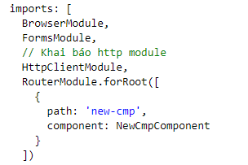
4.8 HTTP
Service using http to fetch data from web service

